Slide 1

AN ANALYSIS OF PORTUGUESE BANK MARKETING DATA
Team 11 :
Anjali Mudgal,
Guoshan Yu,
Medhasweta Sen
Notes:
Themes: What is the issue and how would it affect one's nursing practice? What is your group's position on the subject? How can you use EBP to effectively advocate policy addressing the issue?
Slide topics:
-Overview
-History
-NLC vs eNLC
-eNLC Adoption Process
-Current state of eNLC
-Nursing advocacy
-DC vs VA nursing licensure

Slide 2
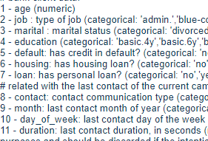
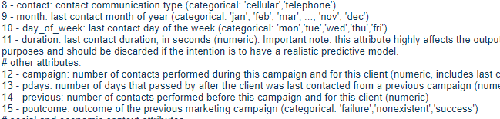
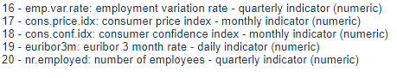

Introducing the data
Bank Client Information
Related with the last contact of the current campaign
social and economic context attributes

Slide 3

PROBLEM STATEMENTS:
1.Relationship between subscribing the term deposit and how much the customer is contacted (last contact, Campaign, Pdays, Previous Number of contacts)
2. Find out the financially stable population? Will that affect the outcome?
3.Effect of dimensionality reduction on accuracy of the model.
4. How are the likelihood of subscriptions affected by social and economic factors?

Slide 4
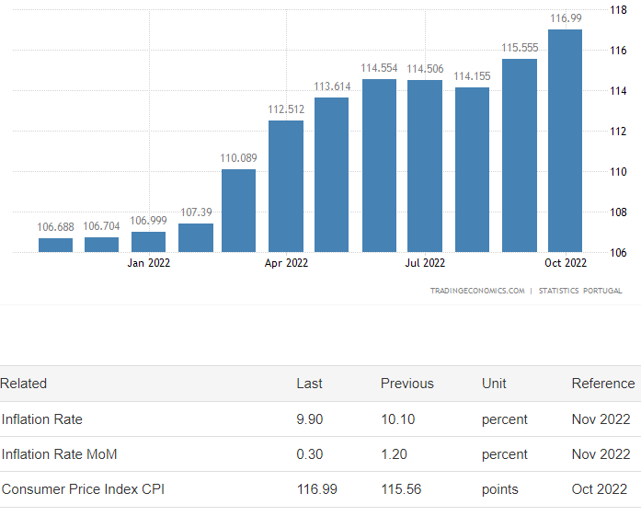
Data Preparation
For Jan, Feb data related to social and economic factors was missing
https://tradingeconomics.com/portugal/consumer-price-index-cpi

Slide 5
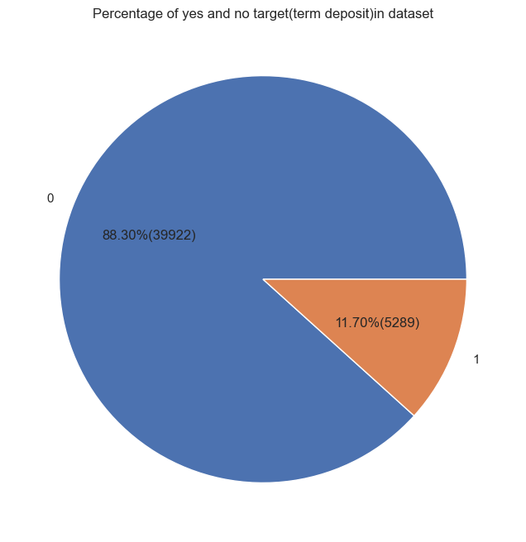
Class Imbalance - target(‘y’)

Slide 6
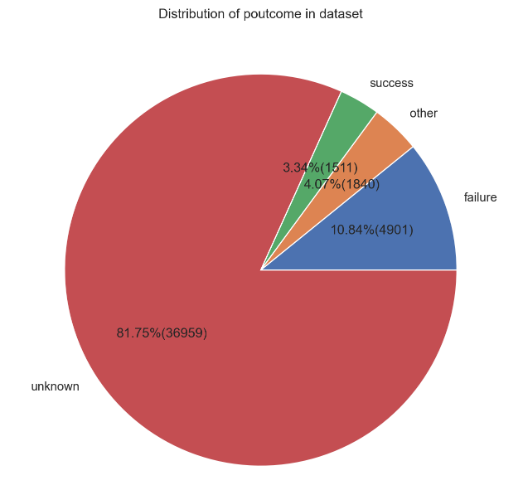
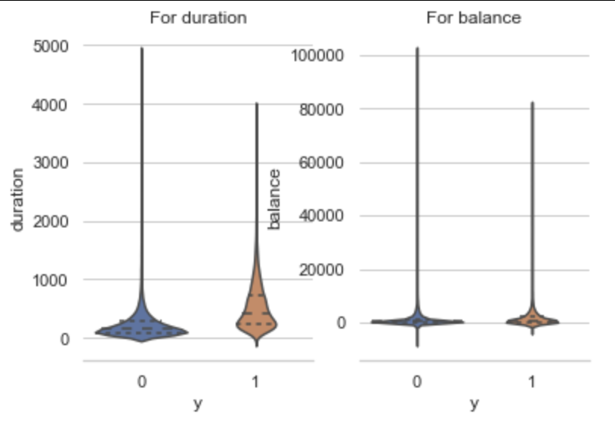
Data Cleaning
Dropped the irrelevant columns
Contact type - Telephone/Cellular
Poutcome - outcome of previous Campaign
Day of contact
Pdays - number of days passed from last contact.
Outliers
Balance - balance in account
Duration - less than 5sec

Slide 7
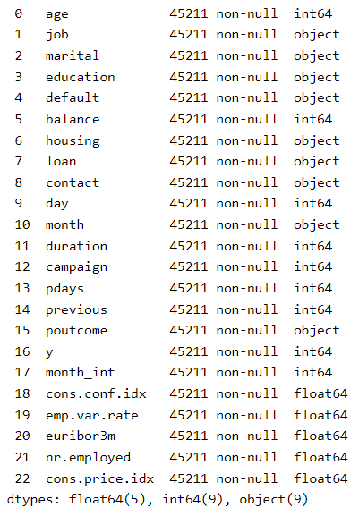

Data Visualization

Slide 8
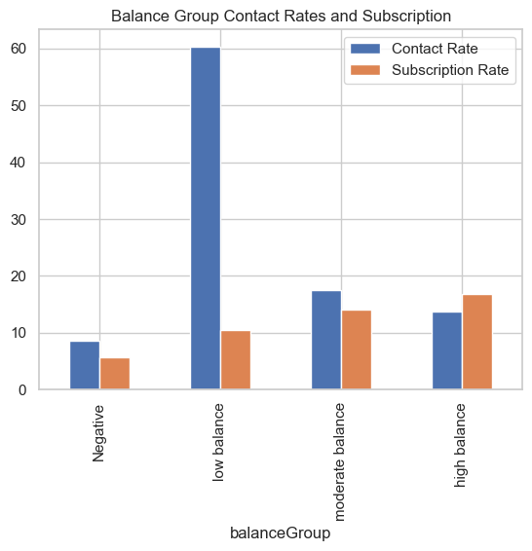
Financially Stable Population
Balance Group
Low Balance - 0-1000
Moderate Balance : 1000-2500
High balance : 2500 - 5000
People with moderate to high balance are contacted less but they are more likely to subscribe to term deposit.

Slide 9
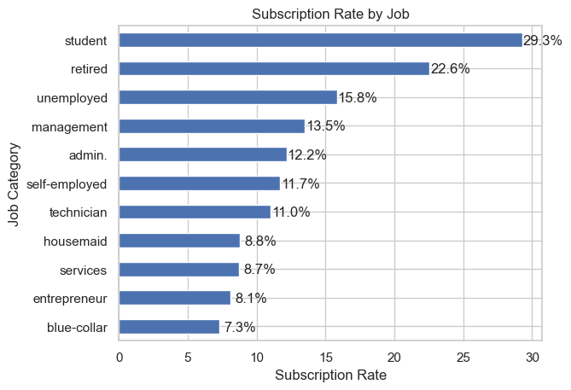
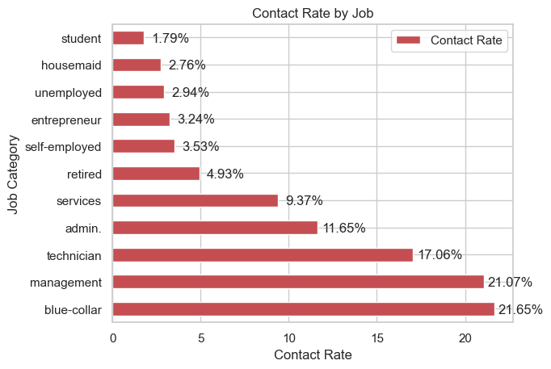
Job
Student, retired, unemployed are more likely to subscribe
But blue-color and management jobs are contacted more.

Slide 10
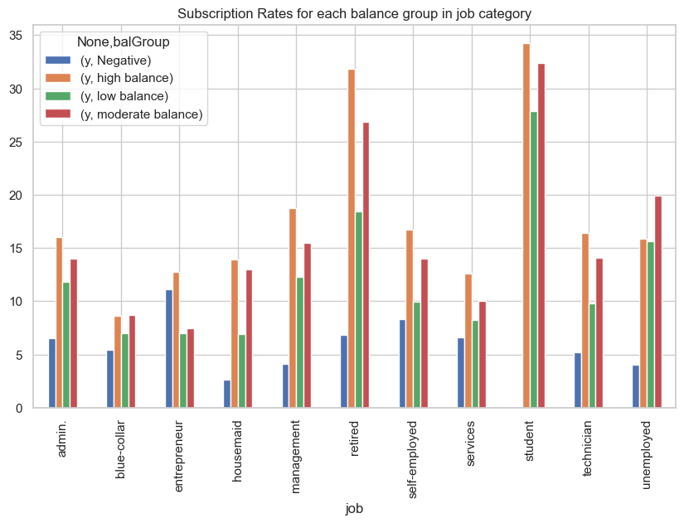
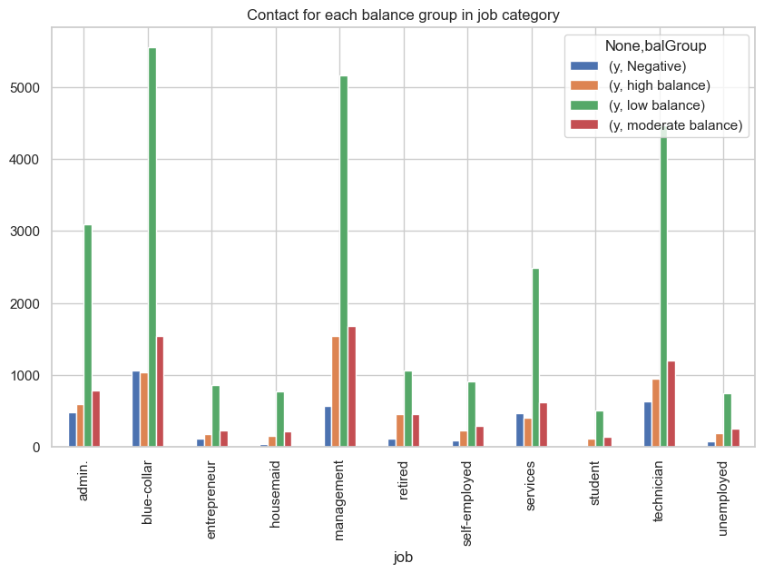
Balance and Jobs
Students and unemployed are highly likely to subscribe to the term deposit, but the contact rate is relatively low.
Should considering targeting the moderate and high balance group

Slide 11
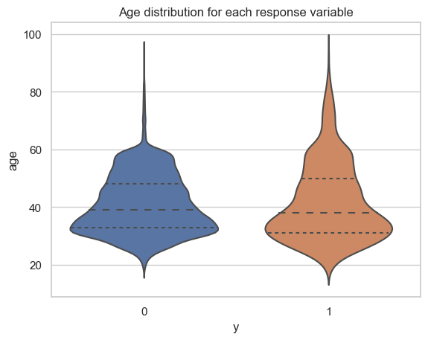
Age
The elders are more likely to subscribe to term deposits
MIddle Age are distributed more evenly for both decisions

Slide 12
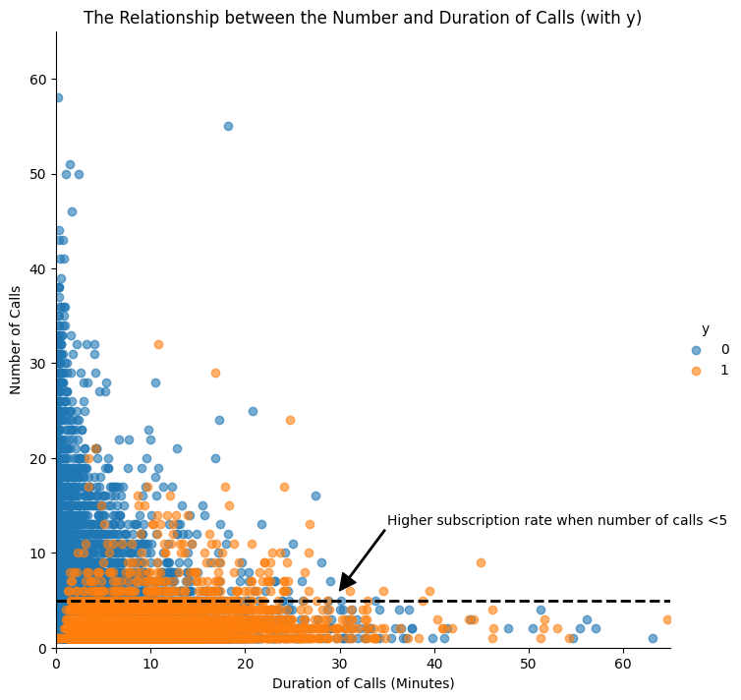
Number of Calls and Duration
People are more likely to subscribe when the number of calls are less than 5.
From the previous customers they should target the people who they have called less than 5 times.

Slide 13
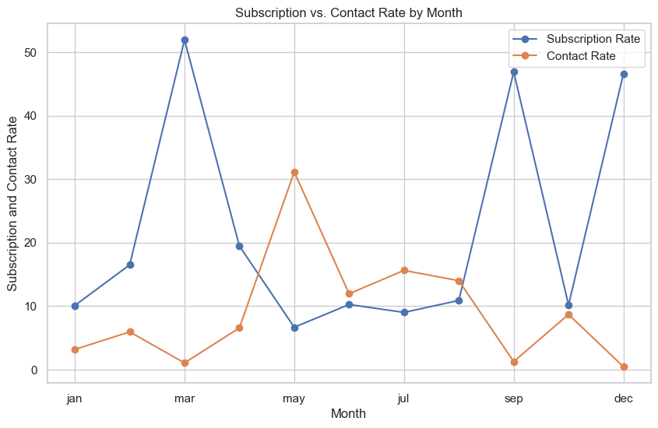
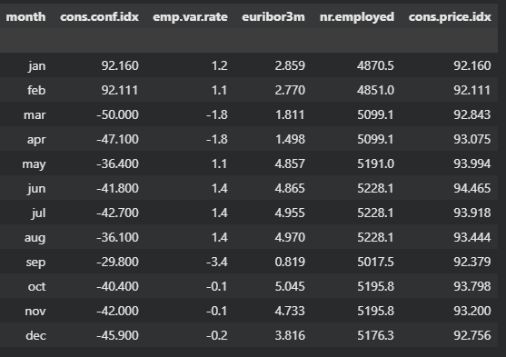
Month wise Subscription Rates
Should contact more in March, Sep, Dec instead of May
No direct relation with social and economic factors is observed here.

Slide 14
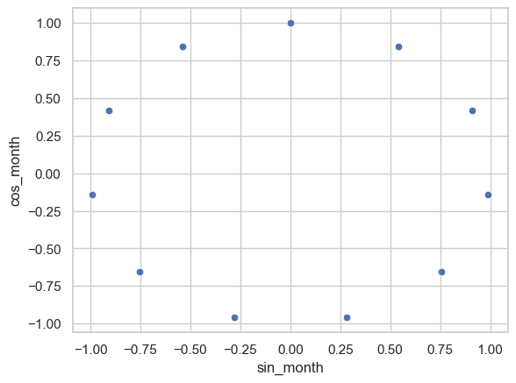
Modelling Preparation
Cyclic Encoding
One Hot Encoding
Scaling
Maintains the original relationship of variables
saves from the problem of curse of dimensionality
Mostly used when we have cyclic relationship in variables
Job
Loan
Education
Age
Duration
Balance

Slide 15
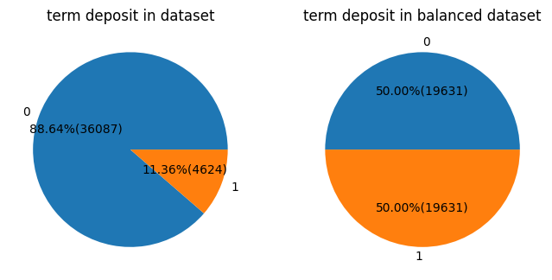
Balancing the Dataset
88% accuracy when all are predicted no
balance the dataset using SMOTE (which uses k means internally) to generate new points

Slide 16
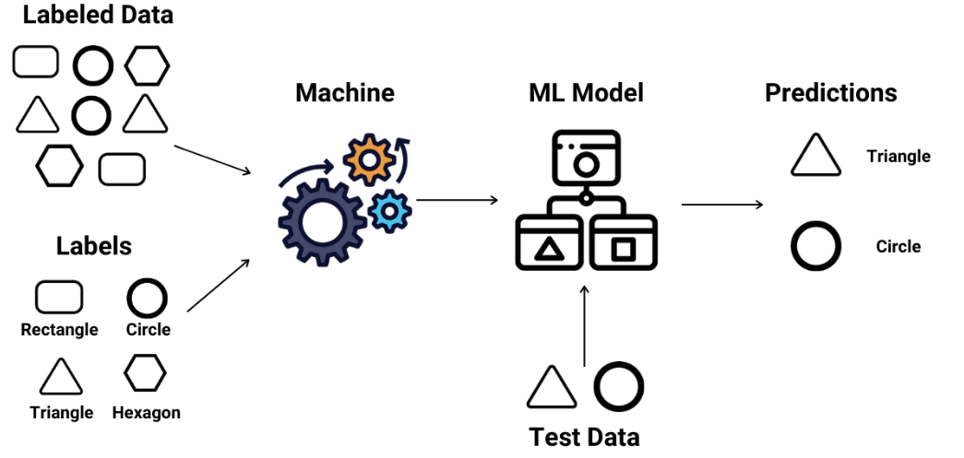
Models Built
Logistic Regression
Decision Tree
Random Forest Classification
SVC
Naive Bayes
KNN

Slide 17
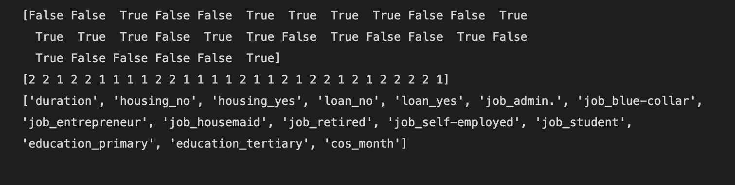
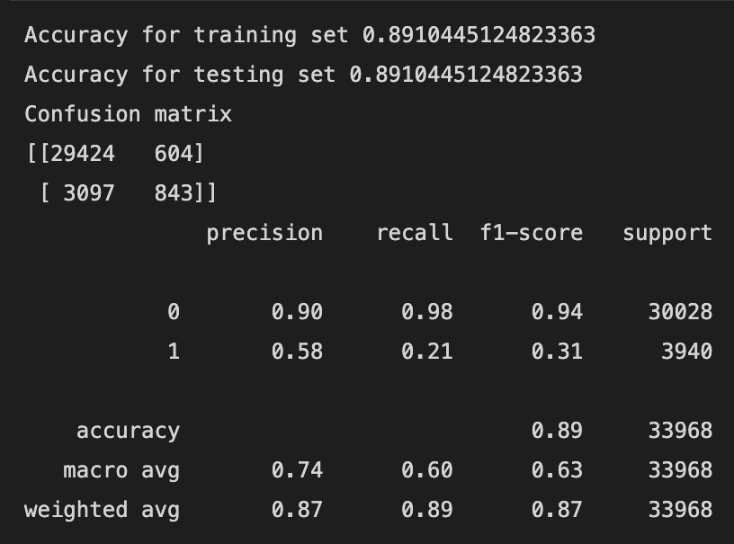
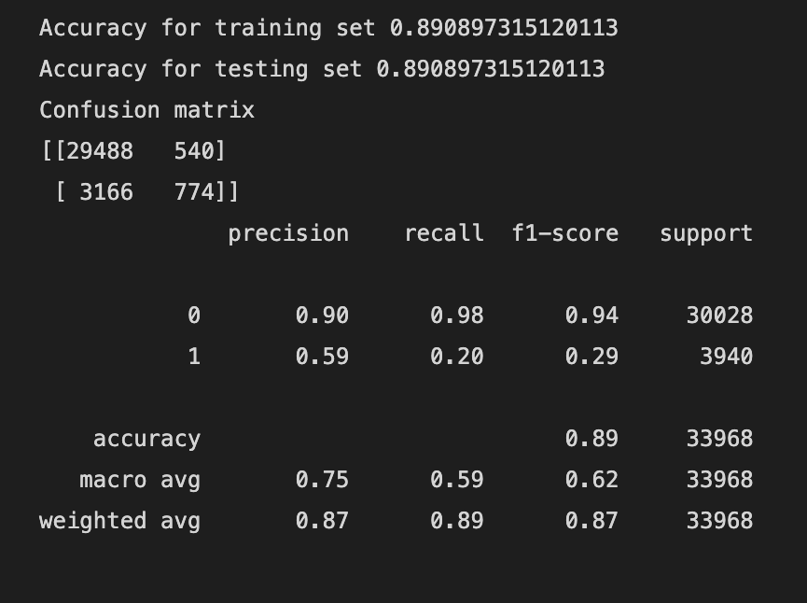
Logistic Regression

Slide 18
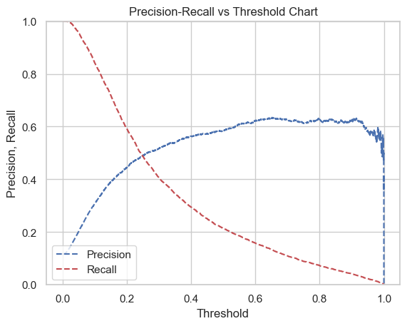
Logistic Regression: Precision- Recall vs Threshold Curve

Slide 19
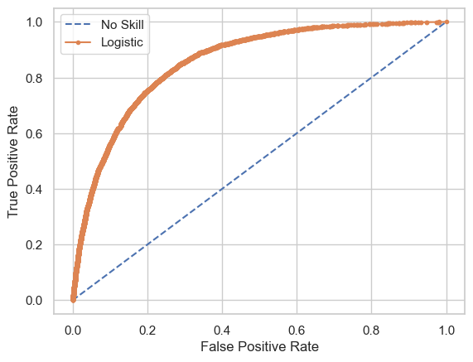
Logistic Regression : ROC Curve

Slide 20
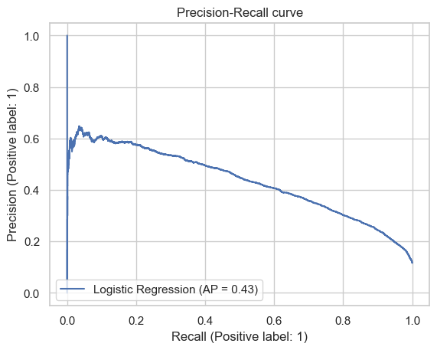
Logistic Regression : PR Curve

Slide 21
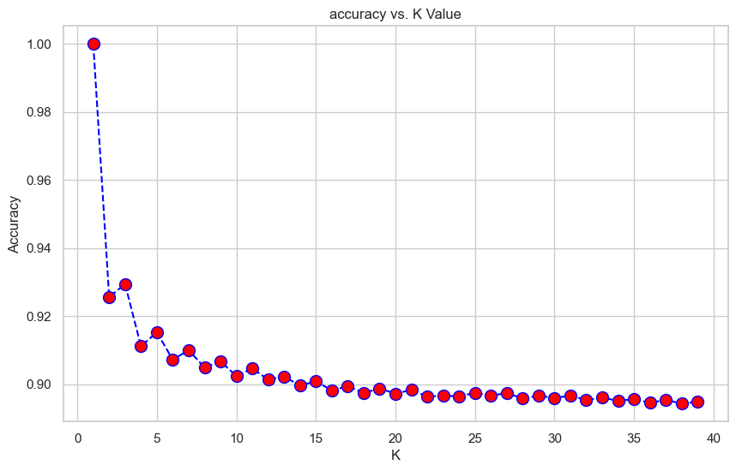
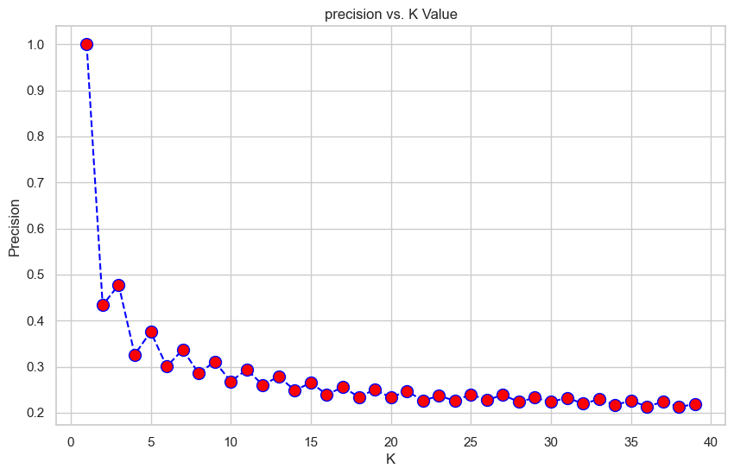
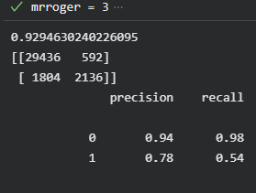
KNN
optimal k value of 3

Slide 22
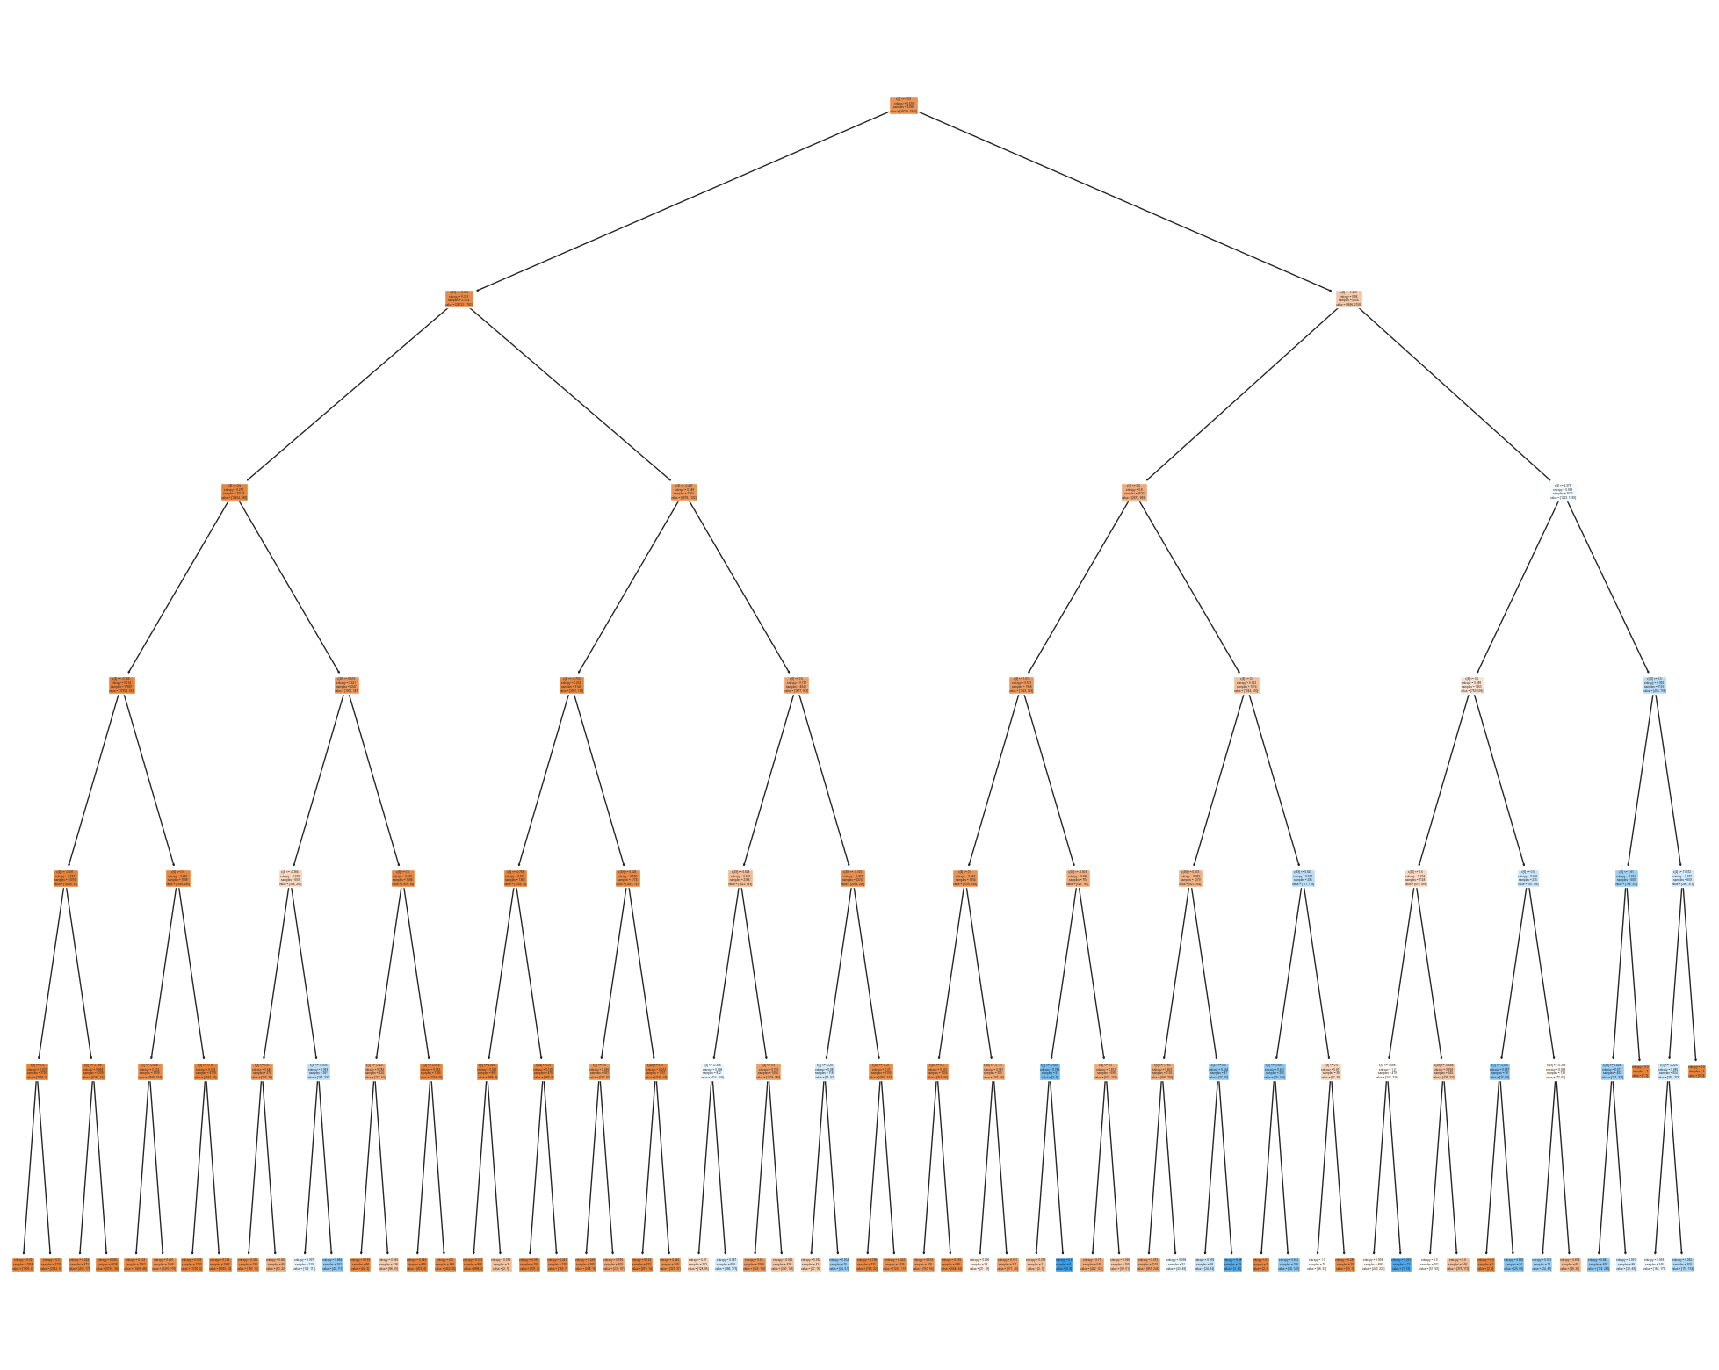
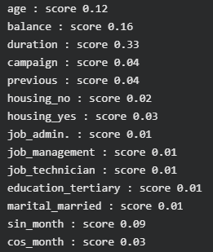
Decision Tree
Feature Selection
Fit model selection

Slide 23
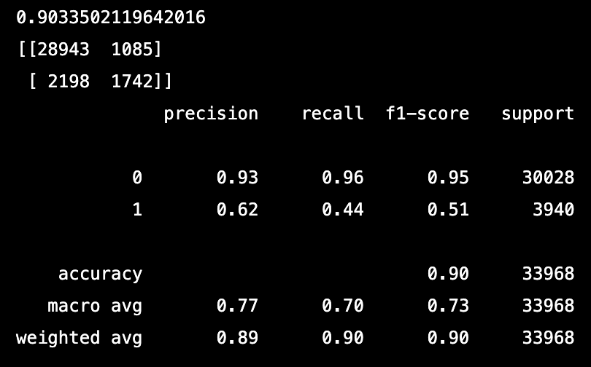
Decision Tree
Modelling outcome

Slide 24
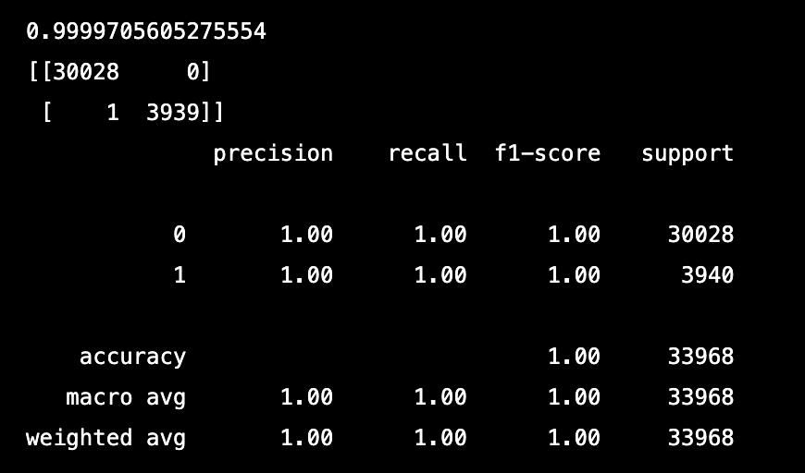
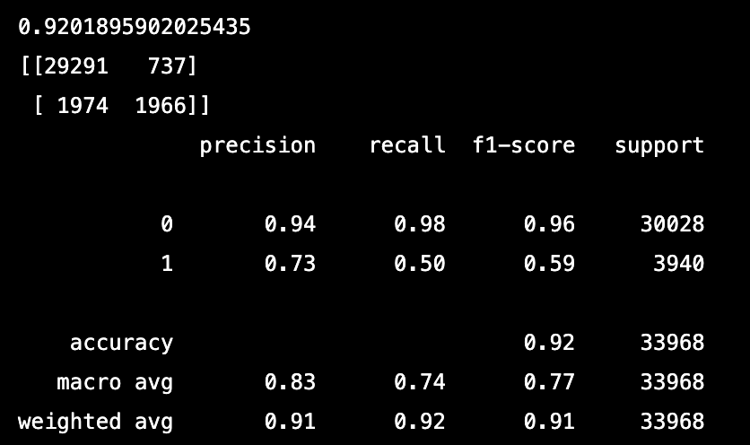
Random Forest
Default setting
Parameter selection

Slide 25
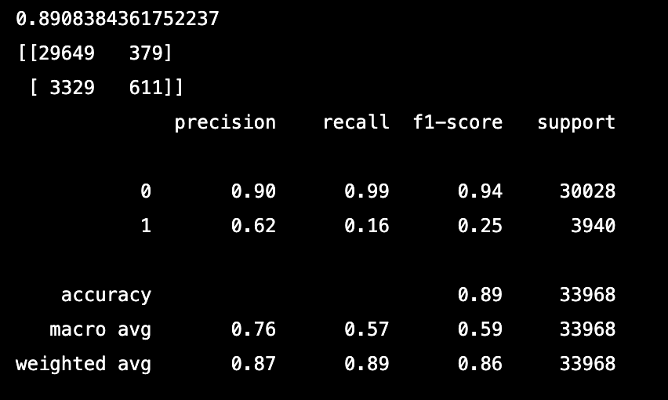
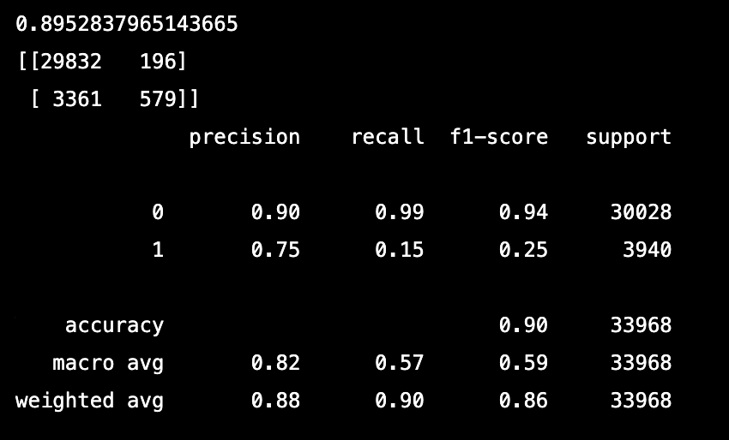
Linear SVC
SVC

Slide 26
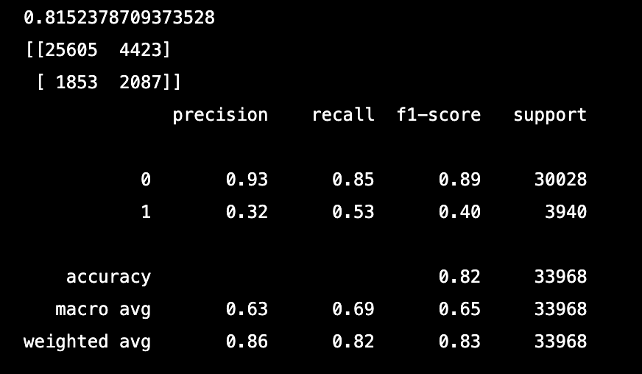
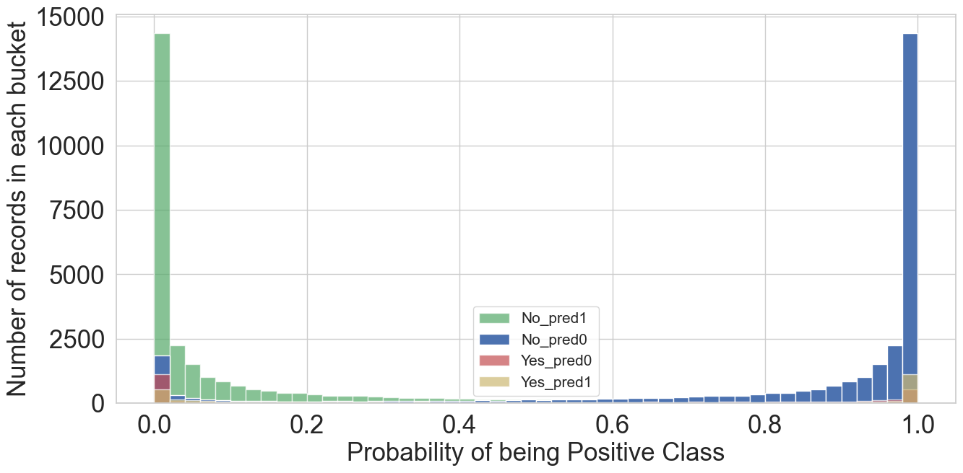
Naive Bayes
Naive Bayes makes a Naive assumption that the x variables( features ) are independent of each other.

Slide 27
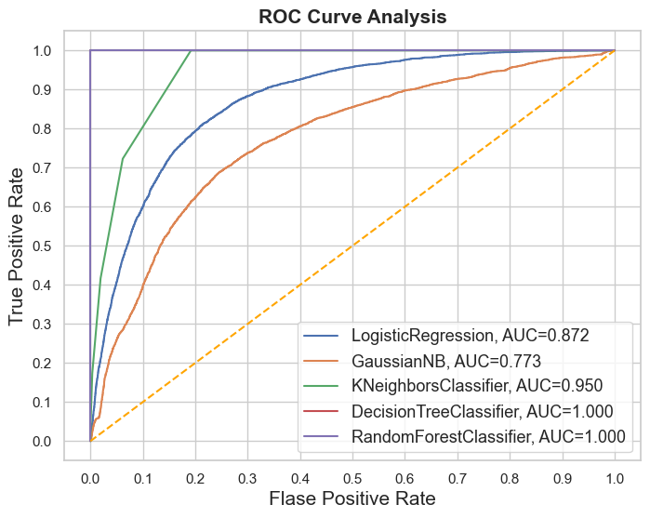
ROC Curve All Models
ROC:Classifiers that give curves closer to the top-left corner indicate a better performance.
AUC. It is equivalent to the probability that a randomly chosen positive instance is ranked higher than a randomly chosen negative instance

Slide 28
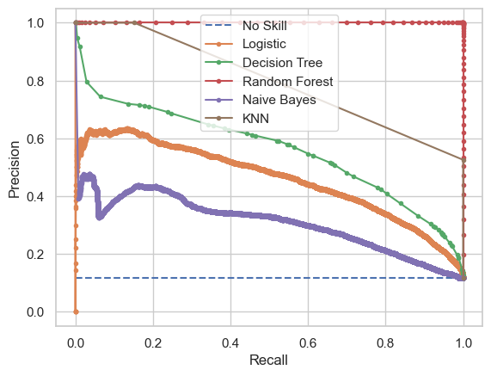
Precision Recall Curve
It is often used in situations where classes are heavily imbalanced.
A good classifier will maintain both a high precision and high recall across the graph, and will “hug” the upper right corner in the figure

Slide 29

CONCLUSION
Number of calls is more significant for decision
Financially stable population( students, retired and unemployed) should be contacted more
Precision and recall improved after incorporating the important features
No significant effect from social and economic factors

Slide 30
THANK YOU

